Slide 1
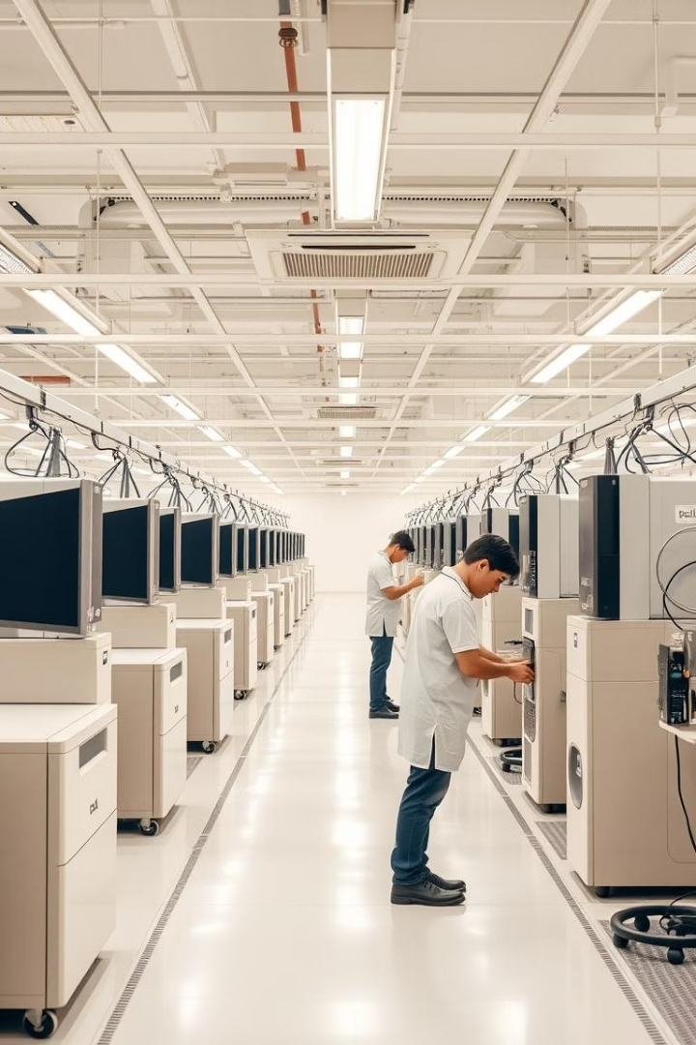
From Order to Assembly: Enhancing Flexibility in Dell’s Build-to-Order Operations
An in-depth analysis of Dell's strategy blends customization with efficiency.
Explore supply chain and logistics optimizing its build-to-order success.

Slide 2

Dell's Build-to-Order (BTO) Model: A Competitive Advantage
Pioneering BTO
Early adopter in PC industry since the 1990s.
Key Components
Direct sales, modular design, and quick assembly.
Efficient Cycle
5-7 days average order-to-delivery in North America.
Cost Savings
20-30% lower inventory costs than retail models.

Slide 3

Supply Chain Integration: The Foundation of BTO
Local Sourcing
Real-time Information
90%+ parts sourced within 300 miles of plants.
SMI Programs
Proprietary IT platform for seamless data sharing.
Strong Supplier Ties
Cut lead times by 40% through Supplier Managed Inventory.
Partnerships with Intel, Microsoft, Samsung.

Slide 4

Logistics Optimization: Ensuring Timely Delivery
Strategic Plant Locations
Near major transportation hubs to speed shipment.
Trusted Logistics Partners
Collaborations with UPS and FedEx ensure reliability.
High On-Time Delivery
Over 95% packages delivered as promised.
Minimal Warehousing
Cross-docking and JIT reduce inventory costs.

Slide 5
Balancing Customization with Efficiency
Modular Design
Automated Assembly
Demand Analytics
High Volume
Allows millions of product configurations.
Optimizes production based on forecasting trends.
Supports up to 10,000 daily order configurations.
Standard processes increase speed and quality.

Slide 6
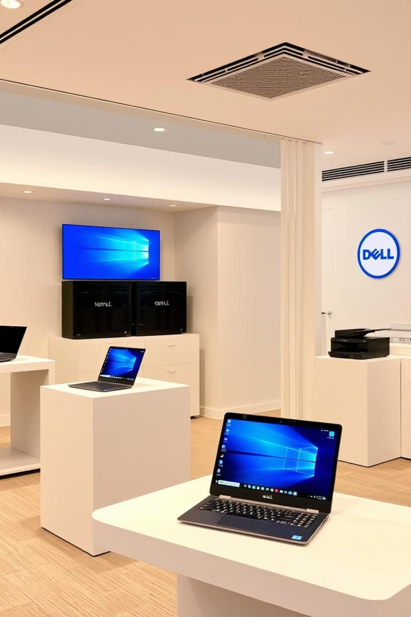



Case Studies: Dell's BTO in Action
Adapting to Market
Custom Server Builds
Product Expansion
Quickly pivoted to netbooks to meet demand.
Tailored configurations for cloud providers.
Integrated printers and storage into BTO offerings.

Slide 7




Challenges and Opportunities
Growing Complexity
More product options increase operational challenges.
Supply Chain Risks
Global disruptions like COVID-19 impact stability.
Customer Demands
Need faster delivery and personalized options.

Slide 8

Conclusion: Key Findings and Recommendations
Maintain BTO Edge
Enhance Integration
Dell's model is a core competitive advantage.
Keep improving supply chain and logistics coordination.
Adopt Technologies
Use AI and automation to boost flexibility and efficiency.

